Slide 1
Clustering-Based Inference for Biomedical Entity Linking
NAACL_2021

Slide 2
The Problem with existing solution
One technique uncommon in BEL that deserves more attention is clustering.
This approach works well when mentions may be difficult to link directly to their ground truth entity, but may have very clear coreference relationships to other mentions.
Most SOTA do not record interaction between intra document mentions , which are similar in nature based on some similarity measure.

Slide 3
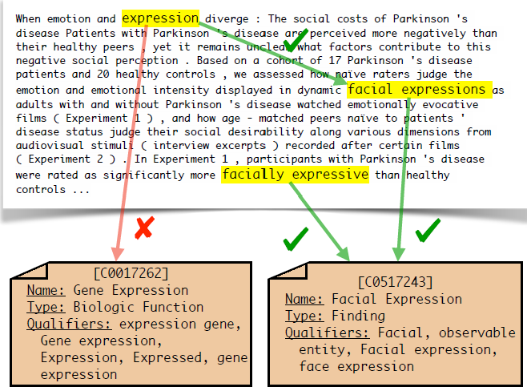
_
So , for both ,zero shot learning or for ambiguous surface mentions this approach should , in theory work well. An Example

Slide 4
Overview of proposed solution
This model builds a graph where nodes are union of all of the mentions and entities and edges - have weights denoting the affinities between the endpoints.
Each cluster has must have one single entity. Mentions are either directly linked or join a cluster for linking to be done.

Slide 5
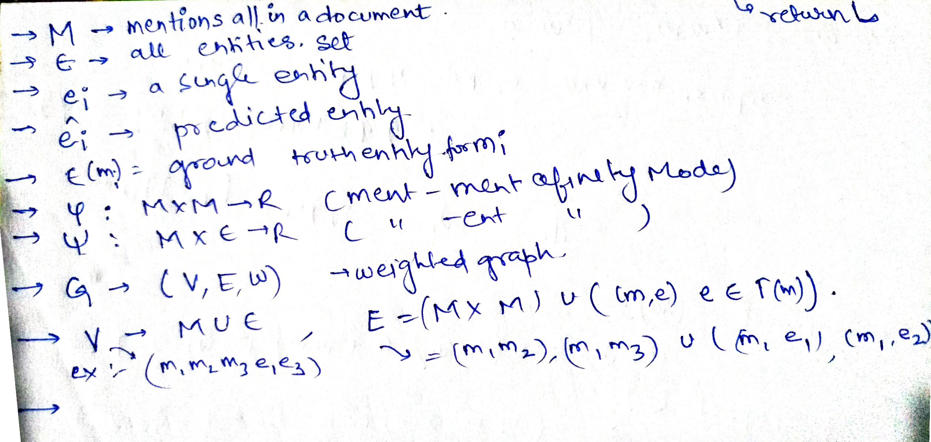
General Symbols

Slide 6
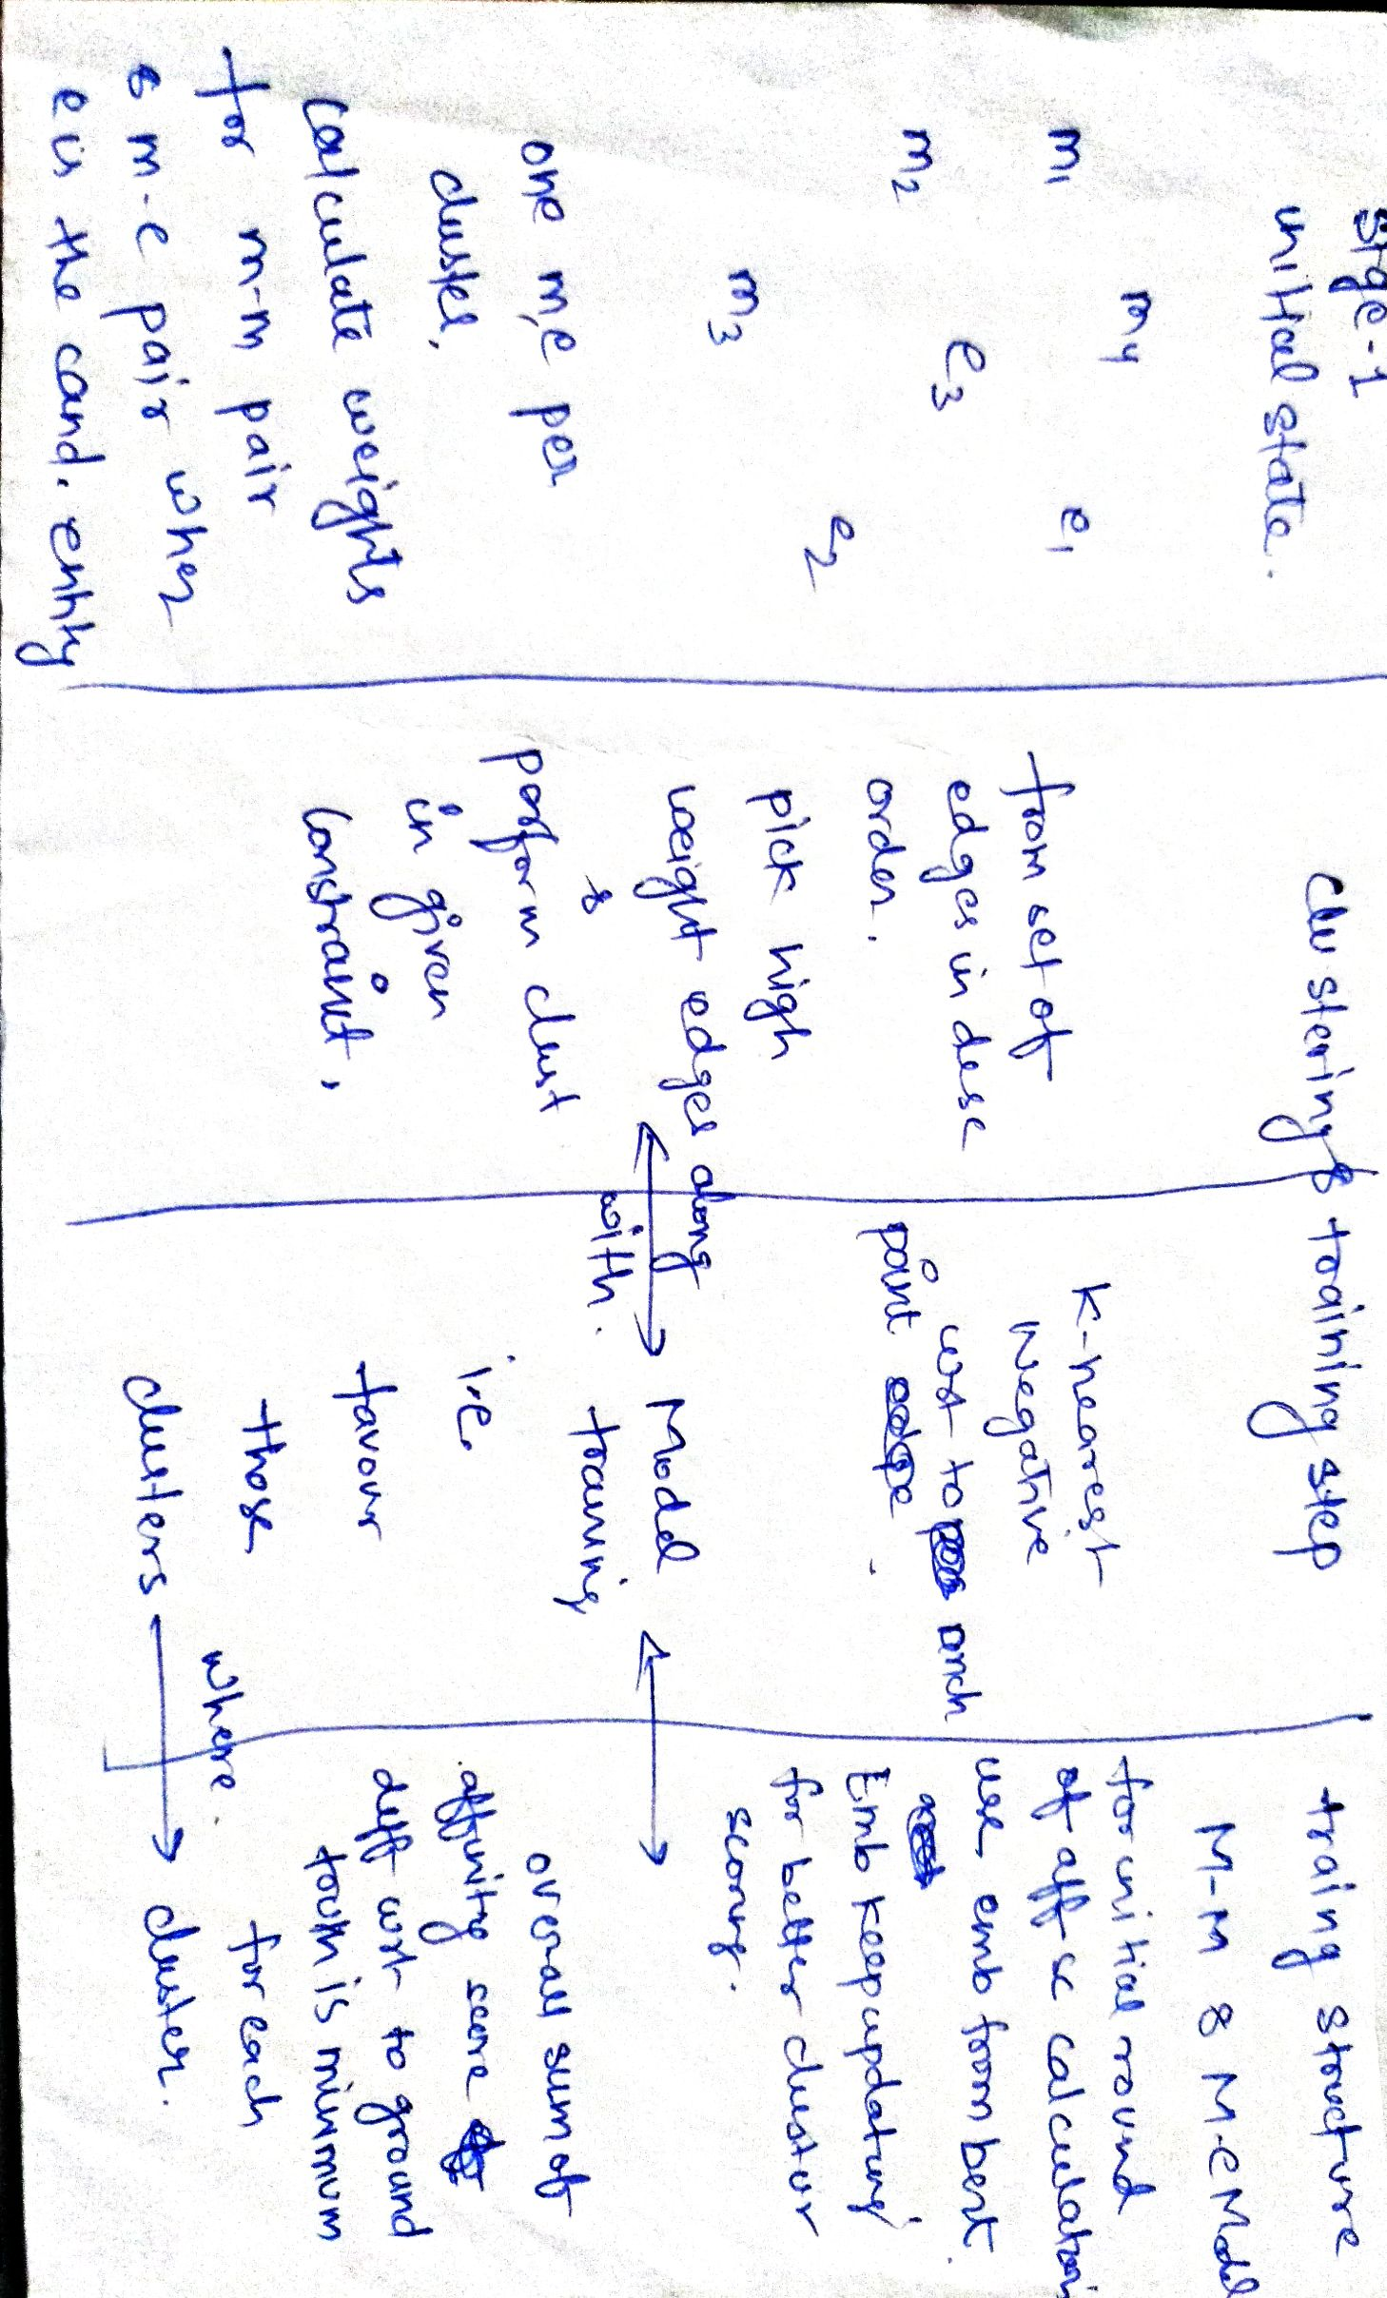
Flow of the process

Slide 7
Model Overview
Affinity here is defined as the score of similarity between two nodes of graph.
When every cluster contains one entity this process terminate. Initial state is one mention per cluster.
There are two trainable models for affinity calc. inititallized with embeddings from BioBert.

Slide 8
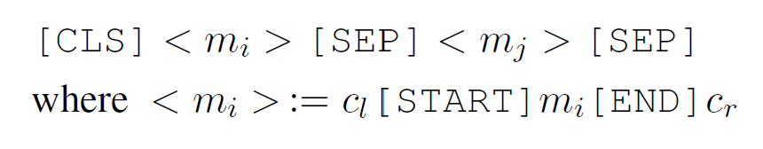
Mention-Mention Model
Is a cross encoder taking input as a pair of mention in context and producing a single scalar affinity for every pair.
The affinity for a mention pair is computed by concatenating their mention representations(embeddings?) and passing it through a linear layer with a sigmoid activation.

Slide 9
Training
Uses a variant of the maximum spanning tree (MST) supervised single linkage clustering algorithm presented in Yadav et al. (2019).
Mention-Mention model runs an algorithm to perform clustering based on scores generated by a trainable model.
The objective is to minimize the following loss triplet max-margin with margin mu for each cluster C*

Slide 10
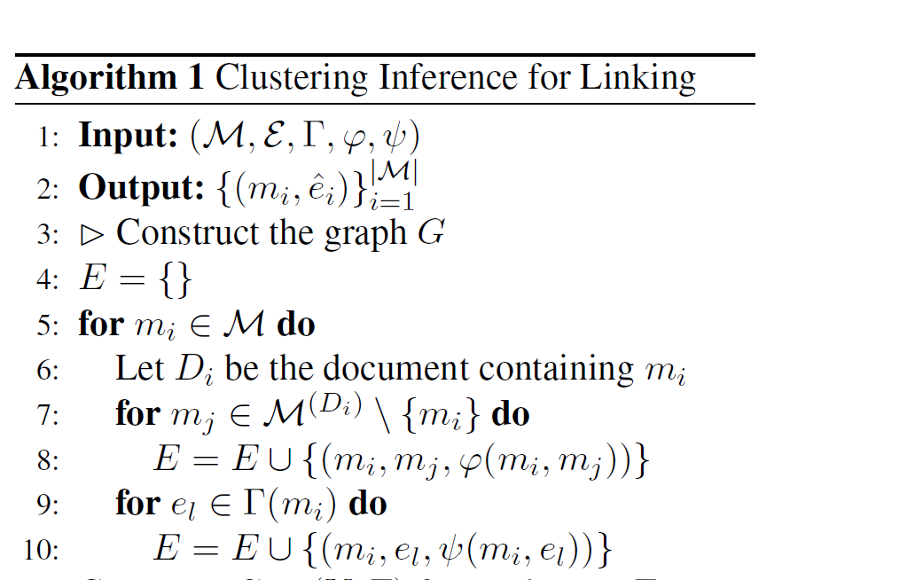
Clustering Algorithm (MST based)

Slide 11
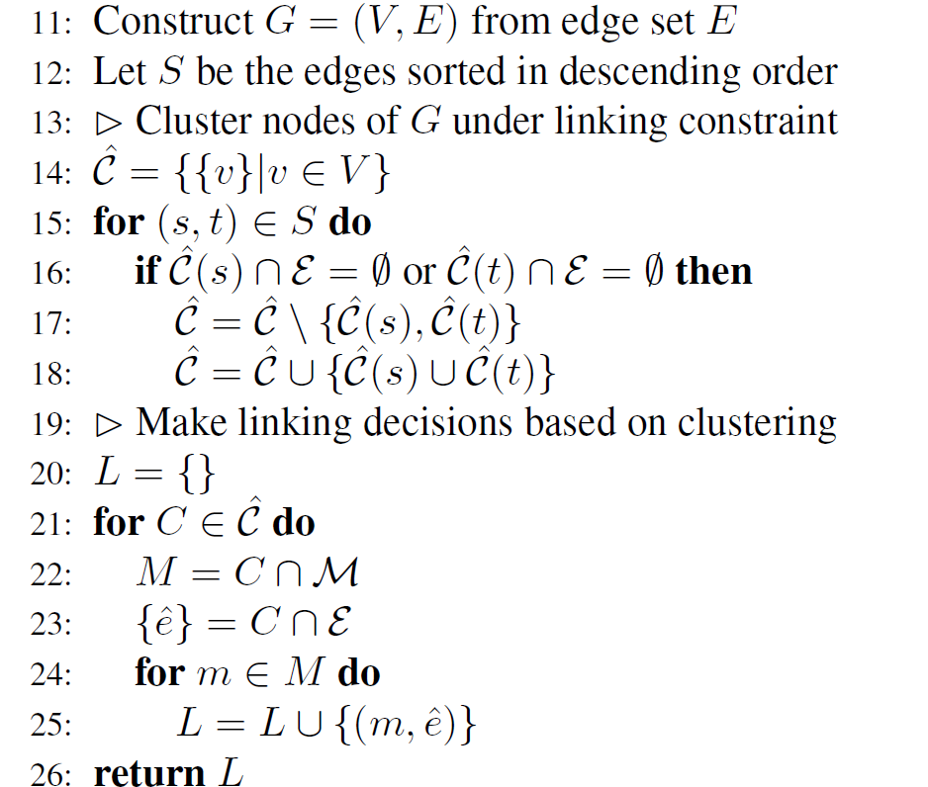
_(a-b)

Slide 12
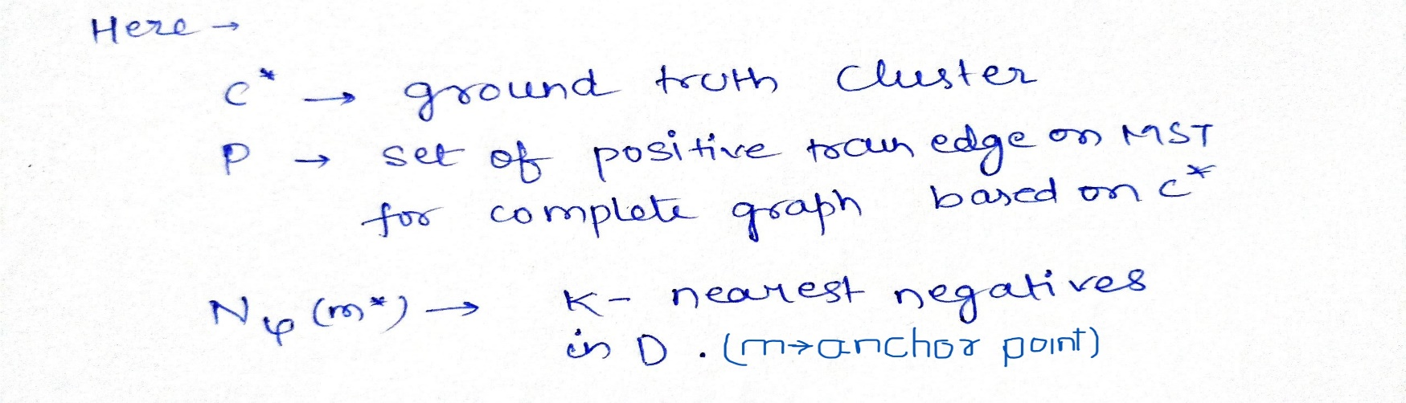
Notation for loss function terms
The objective of loss function is to keep those negatives which are closest from ground truth only i.e. build a closely knit cluster wrt to anchor point.
for each anchor point and positive edge node pair , sum over diff between all negative candidates affinity with anchor and pos with anchor and minimize this sum .(assumption).positive here is ground truth .

Slide 13
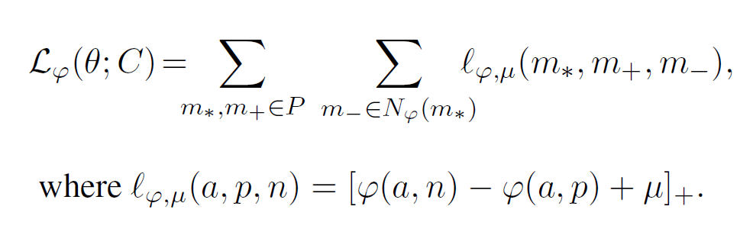
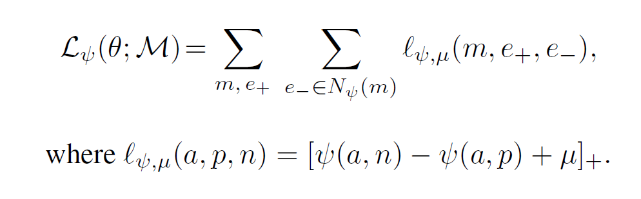
Loss Functions for the affinity models
For each cluster C belonging to C* (true) minimize :
Similarly for mention entity model training objective is to minimize:

Slide 14
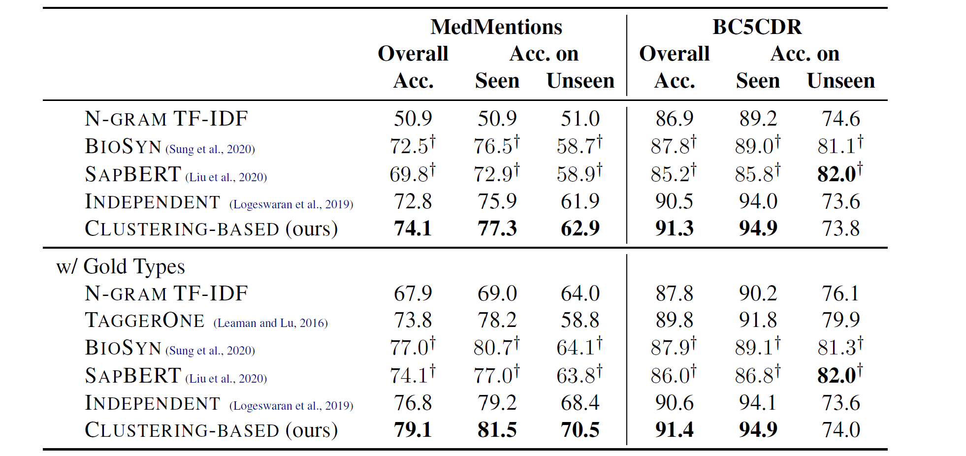
Results
D

Slide 15
Candidate generation
N-gram TFIDF model to produce candidates .
The candidate generator utilizes the 200k most frequent character-n-grams, and the 200k most frequent words in the names in E to produce sparse vectors for all E of the mentions and entity descriptions.
We show through analysis that our approach is better suited to link mentions with ambiguous surface forms and link mentions where the ground truth entity is not in the candidate set.

Slide 16
Results
Mention-mention relationships are also explored in some previous works also. These works use attention in a way to build the context representation of the mentions. However, as mentioned by Logeswaran et al. (2019) is not well suited for zero-shot linking.

